Slide 1

GUIDED BY PRESENTED BY Asst.Prof.L.BHARGAV KUMAR,M.Tech P.GOWRI PRIYA (14JN1A04B1) M.KAVYA (14JN1A0484) N.USHA RANI (14JN1A04A0) M.ARATHI PRIYA(14JN1A0481) P.SIREESHA (14JN1A04B0)
DESIGN AND SIMULATION OF ADVANCED ENCRYPTION STANDARD

Slide 2
CONTENTS
OBJECTIVE
EXISTING METHODS
PROPOSED METHOD
BLOCK DIAGRAM
OPERATION
ENCRYPTION
DECRYPTION
RESULTS

Slide 3
OBJECTIVE
To achieve the requirements for secrecy, integrity and non repudiation of exchanged information, transmission of secret data over the communication.

Slide 4
EXISTING METHODS
DES
3-DES
DISADVANTAGES OF DES,3-DES:
There is a weakness in the design of the cipher.
S box creates same output with two chosen input.
3-DES is not practical when used to encrypt large messages.
These are applicable for only software implementation.

Slide 5
PROPOSED METHOD:
AES
ADVANTAGES:
AES is more secure .
AES supports larger key sizes than 3DES.
AES is faster in both hardware and software.
AES is required by the latest U.S. and international standards.

Slide 6
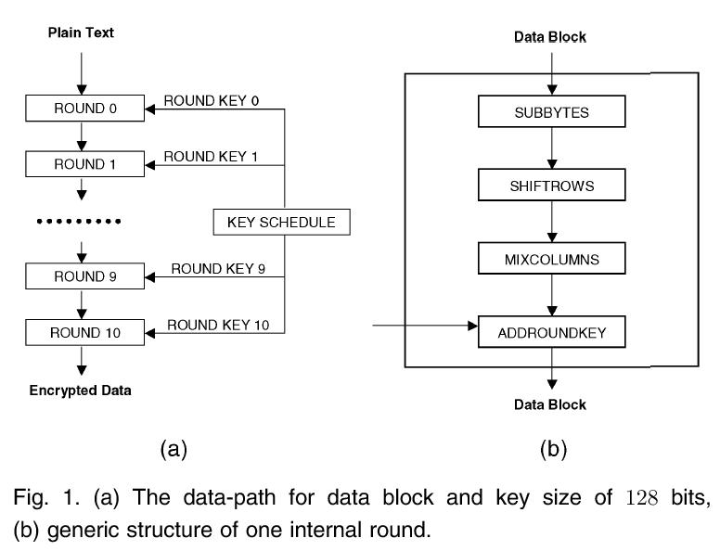
BLOCK DIAGRAM

Slide 7
OPERATION
AES algorithm is a symmetric-key cipher, in which both the sender and receiver use a single key for encryption as well as for decryption. The length of data block is 128 bits. AES algorithm is also an iterative algorithm .Each iteration can be called a round, and the total number of rounds is 10, when key length is 128 respectively.

Slide 8
ENCRYPTION
For encryption, each round consists of the following four steps:
Sub Bytes
Shift Rows
Mix Columns
Add Round Key

Slide 9
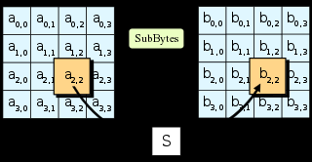
SUB BYTES:
Sub Bytes is the first transformation used at the first site. S box is used in sub byte transformation.

Slide 10
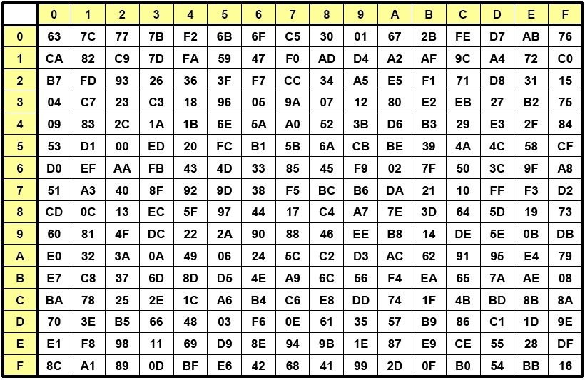
S BOX:

Slide 11
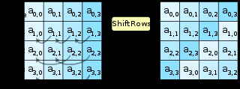
SHIFT ROW:
The Shift Row transformation comprises of four basic steps.

Slide 12
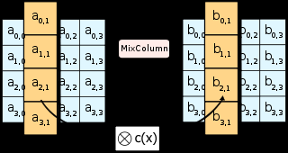
MIX COLUMNS:
The Mix column transformation replaces each byte of a column by a function of all the bytes in the same column.

Slide 13
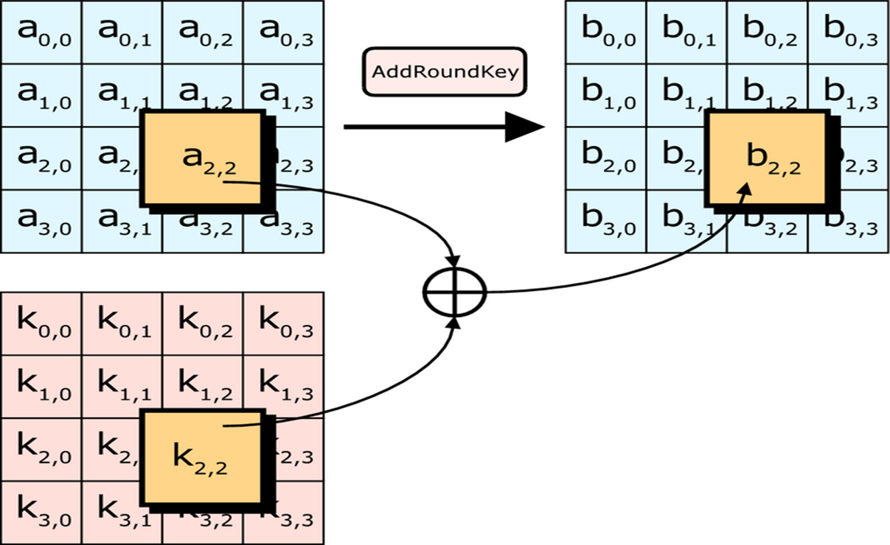
ADD ROUND KEY :
In the Add Round Key step, the sub key is combined with the state. Each round has its own round key that is derived from the original 128-bit encryption key.

Slide 14
DECRYPTION
For decryption, each round consists of following four steps:
1.Inv Sub Bytes
2.Inv Shift Row
3.Inv Mix Column
4.Inv Add Round Key
The process of Decryption is same as Encryption.

Slide 15
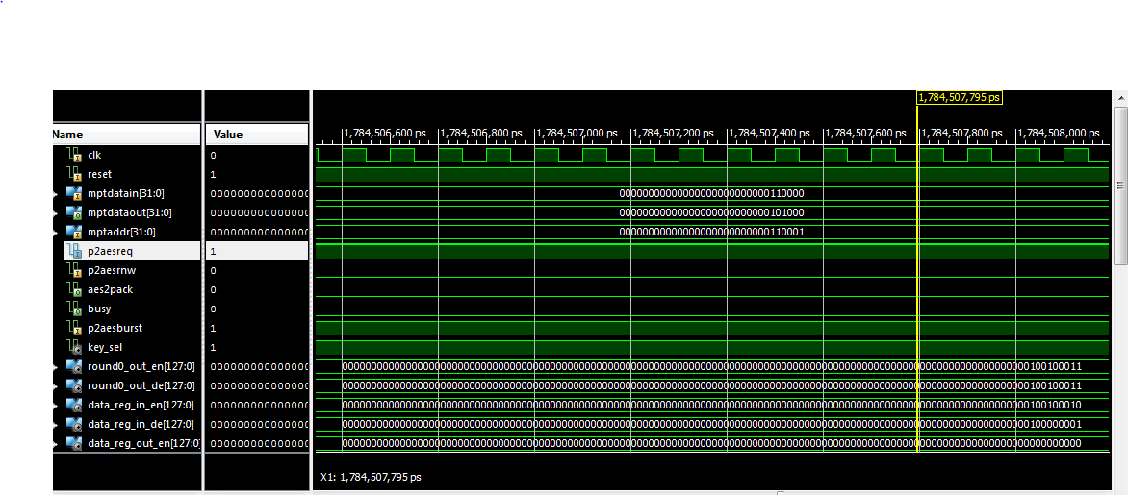
RESULTS
The simulation waveforms for AES is mentioned below.

Slide 16
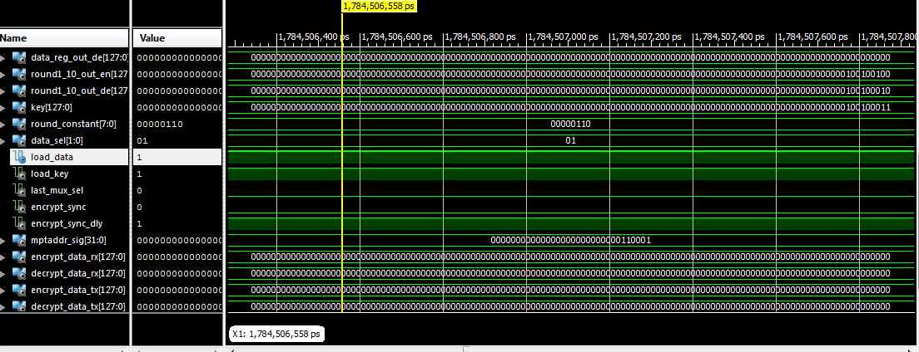

Slide 17
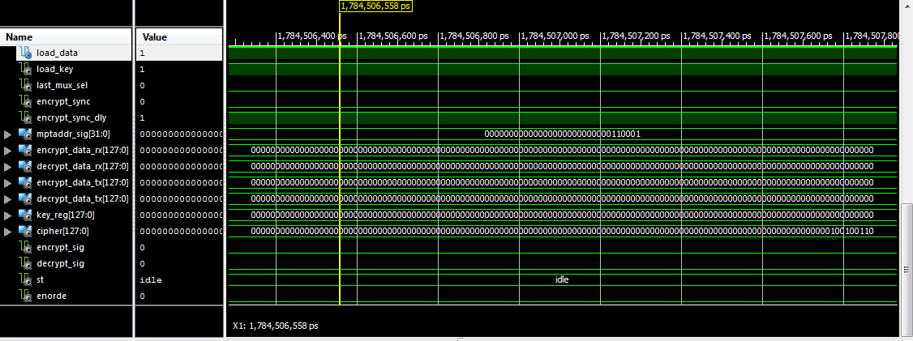

Slide 18
Thank You

